Slide 1
Video Compression - SBI
Powered By - Microsoft Corporation Pvt Ltd.

Slide 2

With the advent of Video Based Customer Identification Process (V-CIP), multiple use cases have emerged for customer onboarding & servicing requests of customers in a secure, paperless, cost-effective & friendly manner.
Storage / retrieval of these video files is a challenge especially given the expected tsunami of video files that are expected to be generated on extending more use-cases to our client base of over 45 crore customers.
Problem Being Solved

Slide 3
Used an online compressor which compresses the video at the frame rate of 6
The original size was of 1MB which was successfully reduced to 592 KB.
The video was a sample video and download was of 1Mb .
Approach taken to create the model

Slide 4
Prerequisites
Sample Video file for testing prototype.
Resolution of the final file.
Frames per second expected in the final file.
Hardware Test bench details

Slide 5
Length of the video = 00.00.05
Frame width = 1280
Frame height = 720
Frame rate = 6 frames/second
Any supporting assumptions, functional requirements(FR) and non-functional requirements(NFR)

Slide 6
My solution has been verifying the problem statement correctly. The problem is well understood and the work is done proficienty . The way of presentation is also well understood. My solution should be considered so that I could be able to work upon myself more and be motivated to learn in this field.
reason why your solution should be considered

Slide 7
https://github.com/Pal-Chat/Techgig_SBI_Hackathon
Source code (Github Repository Link)

Slide 8
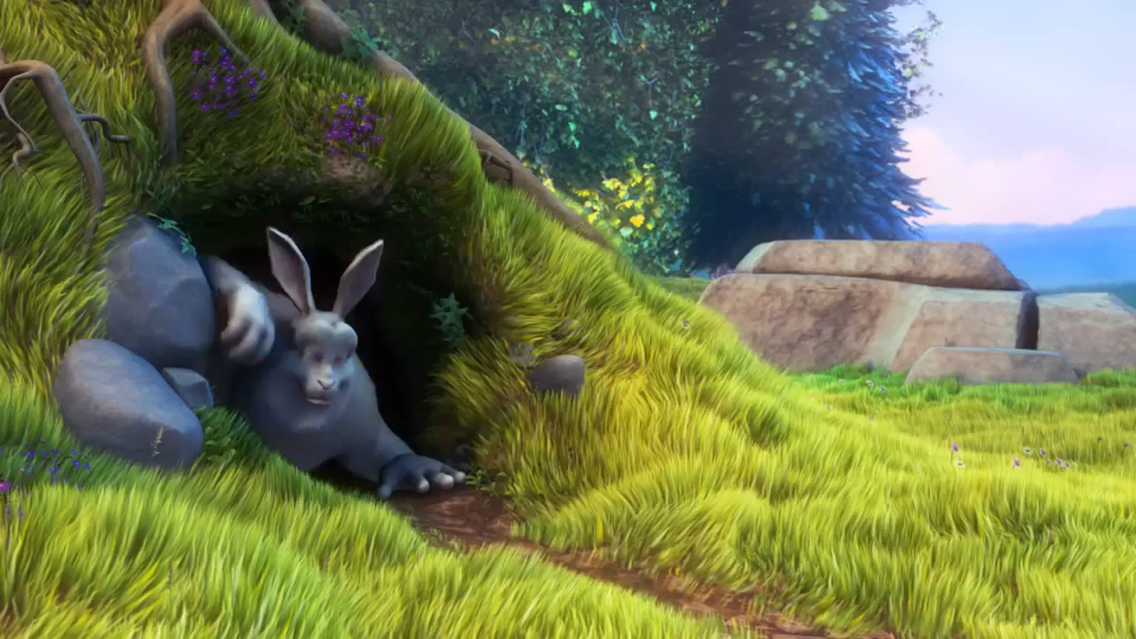

Original video - Size – 1Mb Compressed video – size 592 KB
Demonstration Video showing the
functionalities/working of the solution.

Slide 9

Submitted By : Palak Chaturvedi
Email : p.chaturvedi1212@gmail.com
Mobile No: 8057606896

